Slide 1

Deliverable 2
Project Process
IS 436

Slide 2
Who we are?
Muhammad Hamza - Project Manager
Siril Pattammady - Systems Developer
Josh Johnson - Systems Analyst
Khadija Shafiq - Business Analyst
Jay Patel - Network Engineer
Shaikha Al Shamsi - Requirement Analyst

Slide 3


Recap of Osiris Merger w/ Smith and Nephew
The Osiris to Smith and Nephew merger lead to a large scale integration project for laptop deployment. This involves the implementation of Smith and Nephew information technology department to create a standalone windows image, apply resources, configure systems on a user to user need basis.

Slide 4
Functional Requirements
Process-Oriented
The system shall allow new laptop deployment
The system shall allow new users to merge with new domain
The system shall allow new IOT devices to be connected
The system shall allow request from end users for changes that are needed
The system shall allow different departments to be interconnected
The system shall be assigned to an order to cash ERP System
The system shall allow analyst and developers to make changes.
The system shall be allowed to log existing data.
The system shall have recovery measures for any potential outage.

Slide 5
Non Functional Requirements
Operational/Performance
The system should uphold data integrity
The system should be readily available for users and workers
The system should be manageable by analysts and developers
The system should be secure and recoverable for potential incident
The system should be maintainable after transition from merger
The system should be fairly reliable after all upgrades.
The system should improve productivity and service as ‘old’ system is removed and upgraded.
The system should allow users to login or create new login and password
The system should allow analysts and developers to make changes
The system should allow portability and universal software/OS to be uploaded throughout devices.

Slide 6
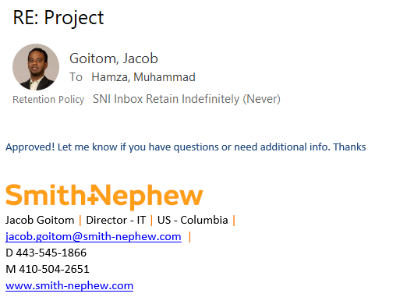
Contact 1
Name of Interviewee: Jacob Goitom
Position of Interviewee: Director of IT, Smith & Nephew
Date and Time of Interview: 10/13/2019
Name of Interviewer: Muhammad Hamza
Questions asked:
Is the current ERP system efficient enough to handle new workload?
What is the timeline for laptop deployments?
Who is going to Image the Machines?
Is there enough on-site support to assist with the integration?
What resources will be required to complete this project in a timely manner?

Slide 7
Contact 2
Name of Interviewee: Joey Caceres
Position of Interviewee: Systems Administrator, Smith & Nephew
Date and Time of Interview: 10/13/2019
Name of Interviewer: Muhammad Hamza
Questions to be asked:
What is your role in the current processes and ERP handling?
How many laptops can be deployed per day to meet quota?
Is your team a responsible team to complete the task assigned?
What resources will be required to complete this project in a timely manner?
What processes can you simplify to ease the task and allow for a better workflow to exist?

Slide 8
Use Case Document

Slide 9
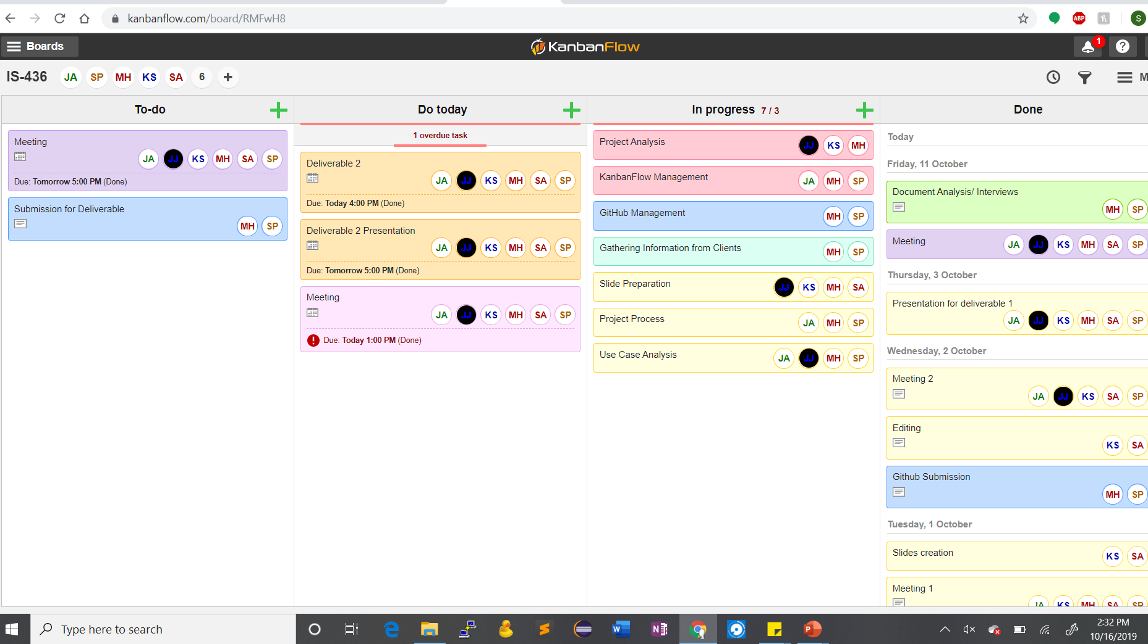
KanbanFlow

